Slide 1

Specialized Visualization Tool

Slide 2
Objectives
Create pie charts using Matplotlib
Create a box plot using Matplotlib
Explain how to generate an Scatter plot using Matplotlib
Specialized Visualization Tool

Slide 3
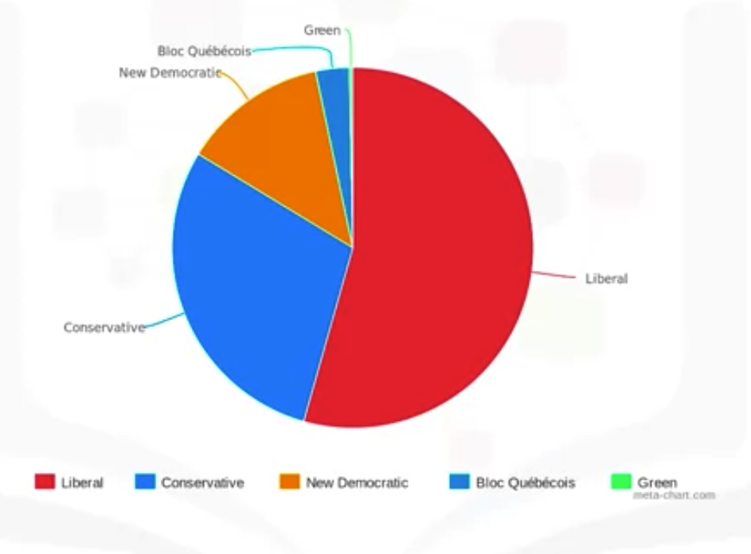
Pie Charts
What is a pie chart?
  A pie chart is a circular statistical graphic divided into slices to illustrate numerical proportions.
Here is a pie chart of the Canadian federal election back in 2015.
→Which party won the most votes?
Specialized Visualization Tool
Notes:
where the Liberals in red won more than 50% of the seats in the House of Commons. That is why the red color occupies more than half of the circle.

Slide 4
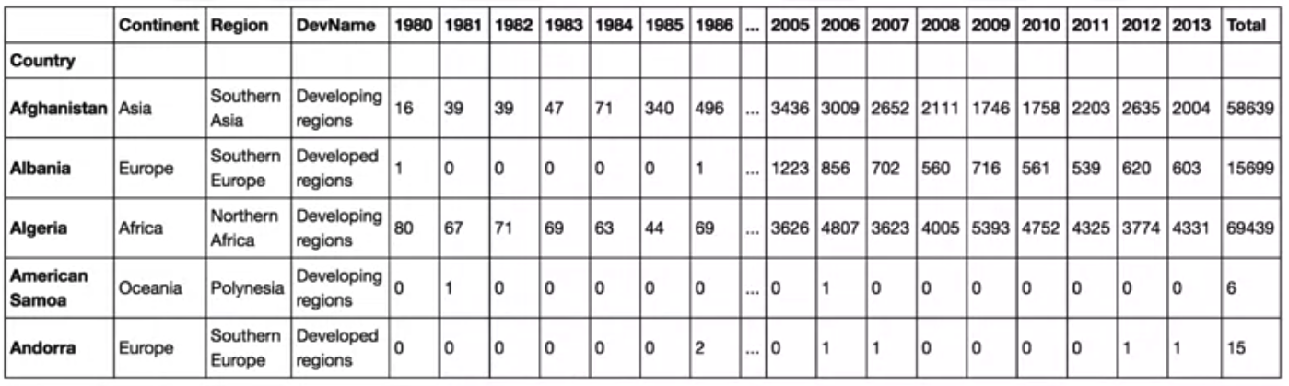
Pie Charts
Processed dataset
  Process the dataframe so that the country name becomes the index of each row.
  Add an extra column which represents the cumulative sum of annual immigration from each country from 1980 to 2013.
Specialized Visualization Tool

Slide 5


Pie Charts
Try the code and show your results
Specialized Visualization Tool

Slide 6
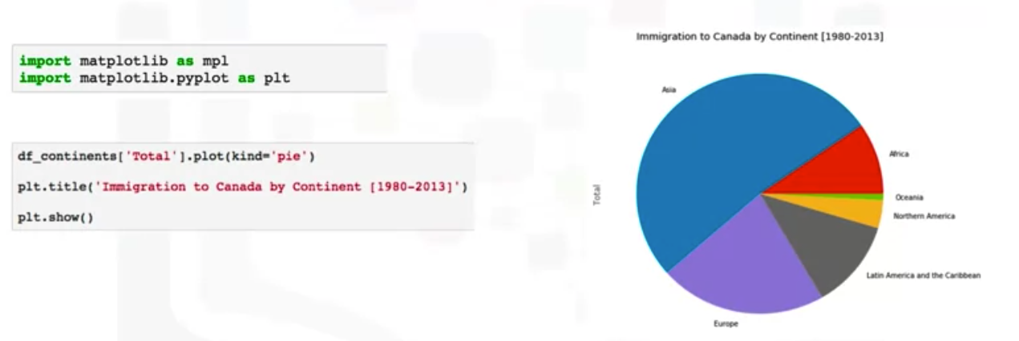
Pie Charts
Specialized Visualization Tool

Slide 7
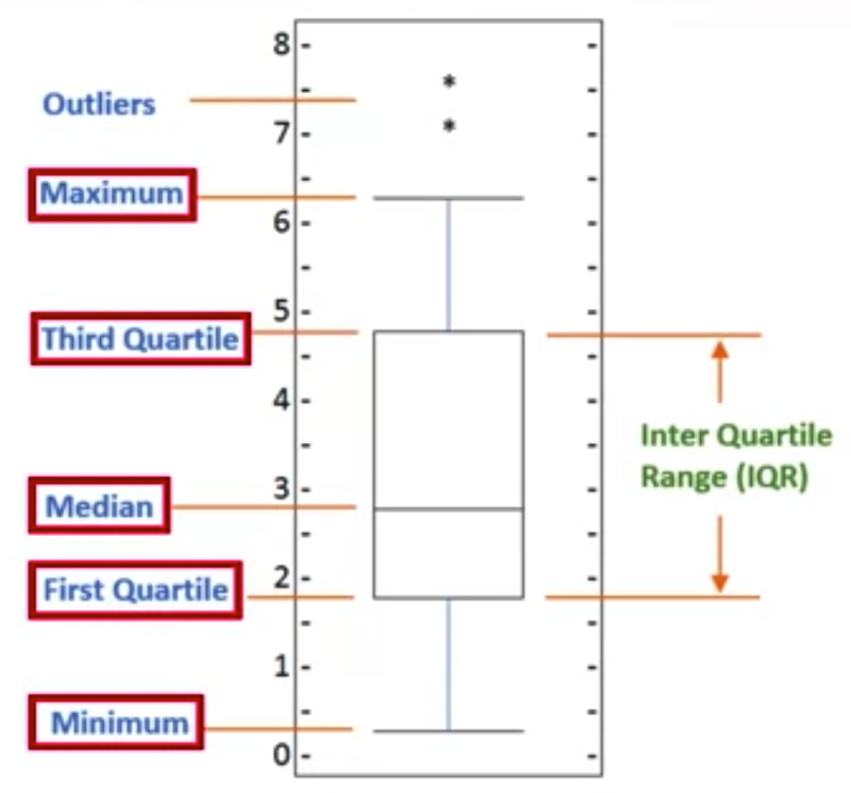
Box Plots
What is a boxplot?
  A boxplot is a way of statistically representing the distribution of given data through 5 main dimensions.
Specialized Visualization Tool

Slide 8
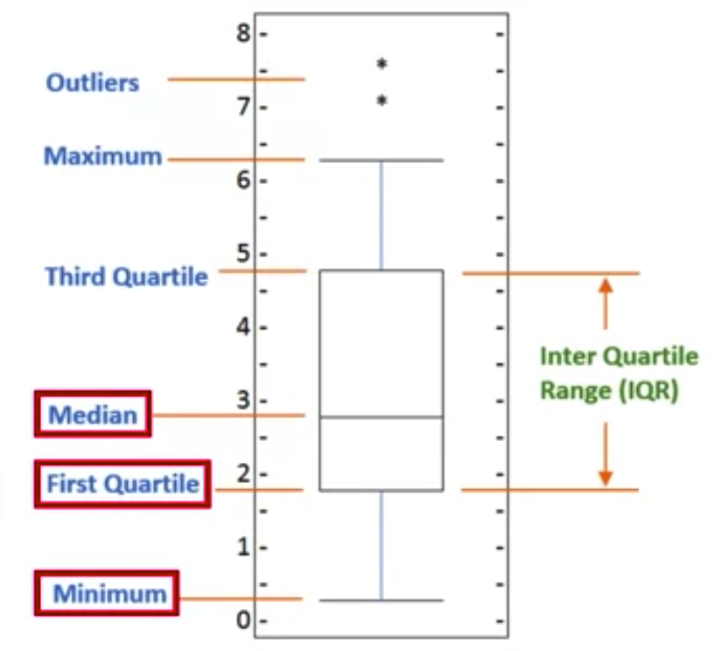
Box Plots
The first dimension is the minimum, which is the smallest number in the sorted data.
The second dimension is the first quartile which is 25% of the way through the sorted data.
The third dimension is the median, which is the median of the sorted data.
Specialized Visualization Tool

Slide 9
Box Plots
The fourth dimension is the third quartile, which is 75% of the way through the sorted data.
The final dimension is maximum, which is the highest number in the sorted data where maximum equals the third quartile summed with 1.5 multiplied by IQR.
Finally, boxplots also display outliers as individual dots that occur outside the upper and lower extremes.
Specialized Visualization Tool

Slide 10
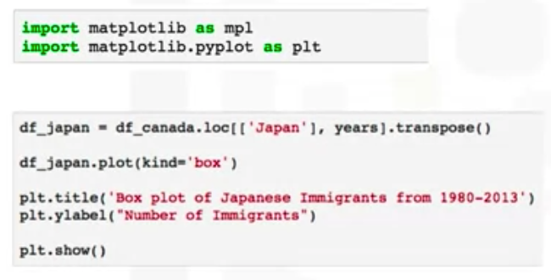
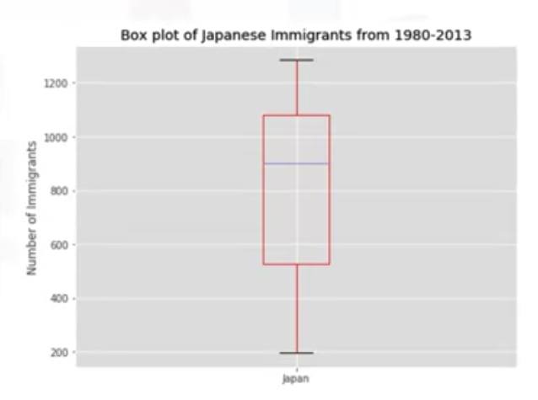
Box Plots
Try the code and show your results
Specialized Visualization Tool

Slide 11
Scatter Plots
What is a scatter plot?
  A scatter plot is a type of plot that displays values pertaining to typically two variables against each other.
  It is a dependent variable to be plotted against an independent variable in order to determine if any correlation between the two variables exists.
Specialized Visualization Tool

Slide 12
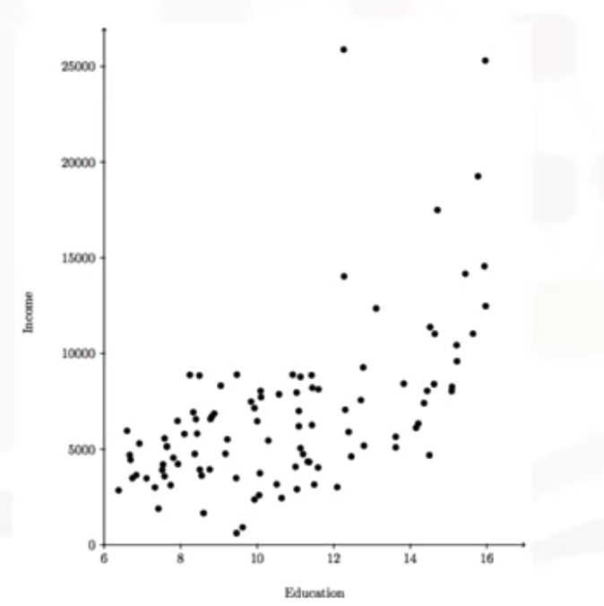
Scatter Plots
Here is a scatter plot of income versus education
  one can conclude that an individual with more years of education is likely to earn a higher income than an individual with fewer years of education.
Specialized Visualization Tool
Notes:
n the lab session, we will walk together through the process of creating df_total from df_canada, so make sure to complete this module's lab session.

Slide 13
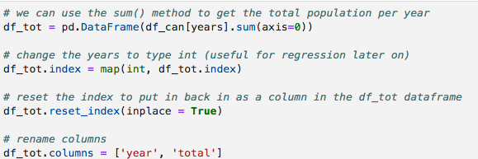
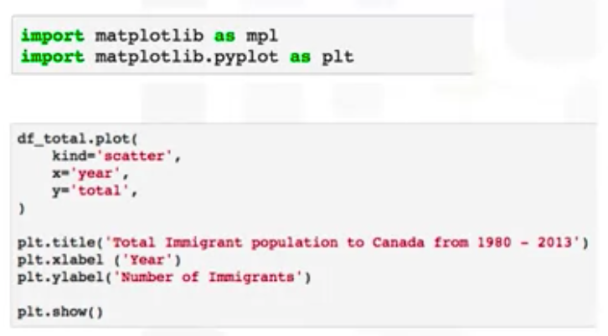
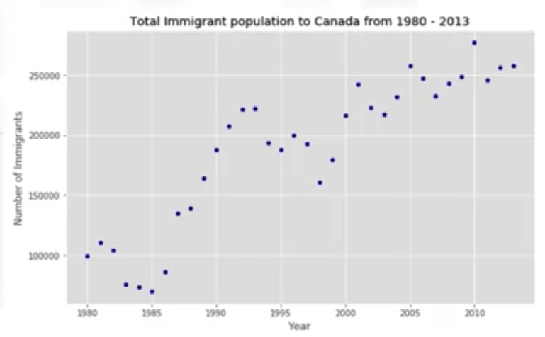
Scatter Plots
Topic11111
Specialized Visualization Tool

Slide 14
Summary
Create pie charts using Matplotlib
Create a box plot using Matplotlib
Explain how to generate an Scatter plot using Matplotlib
Specialized Visualization Tool

Slide 15
Q & A
Specialized Visualization Tool

